Slide 1
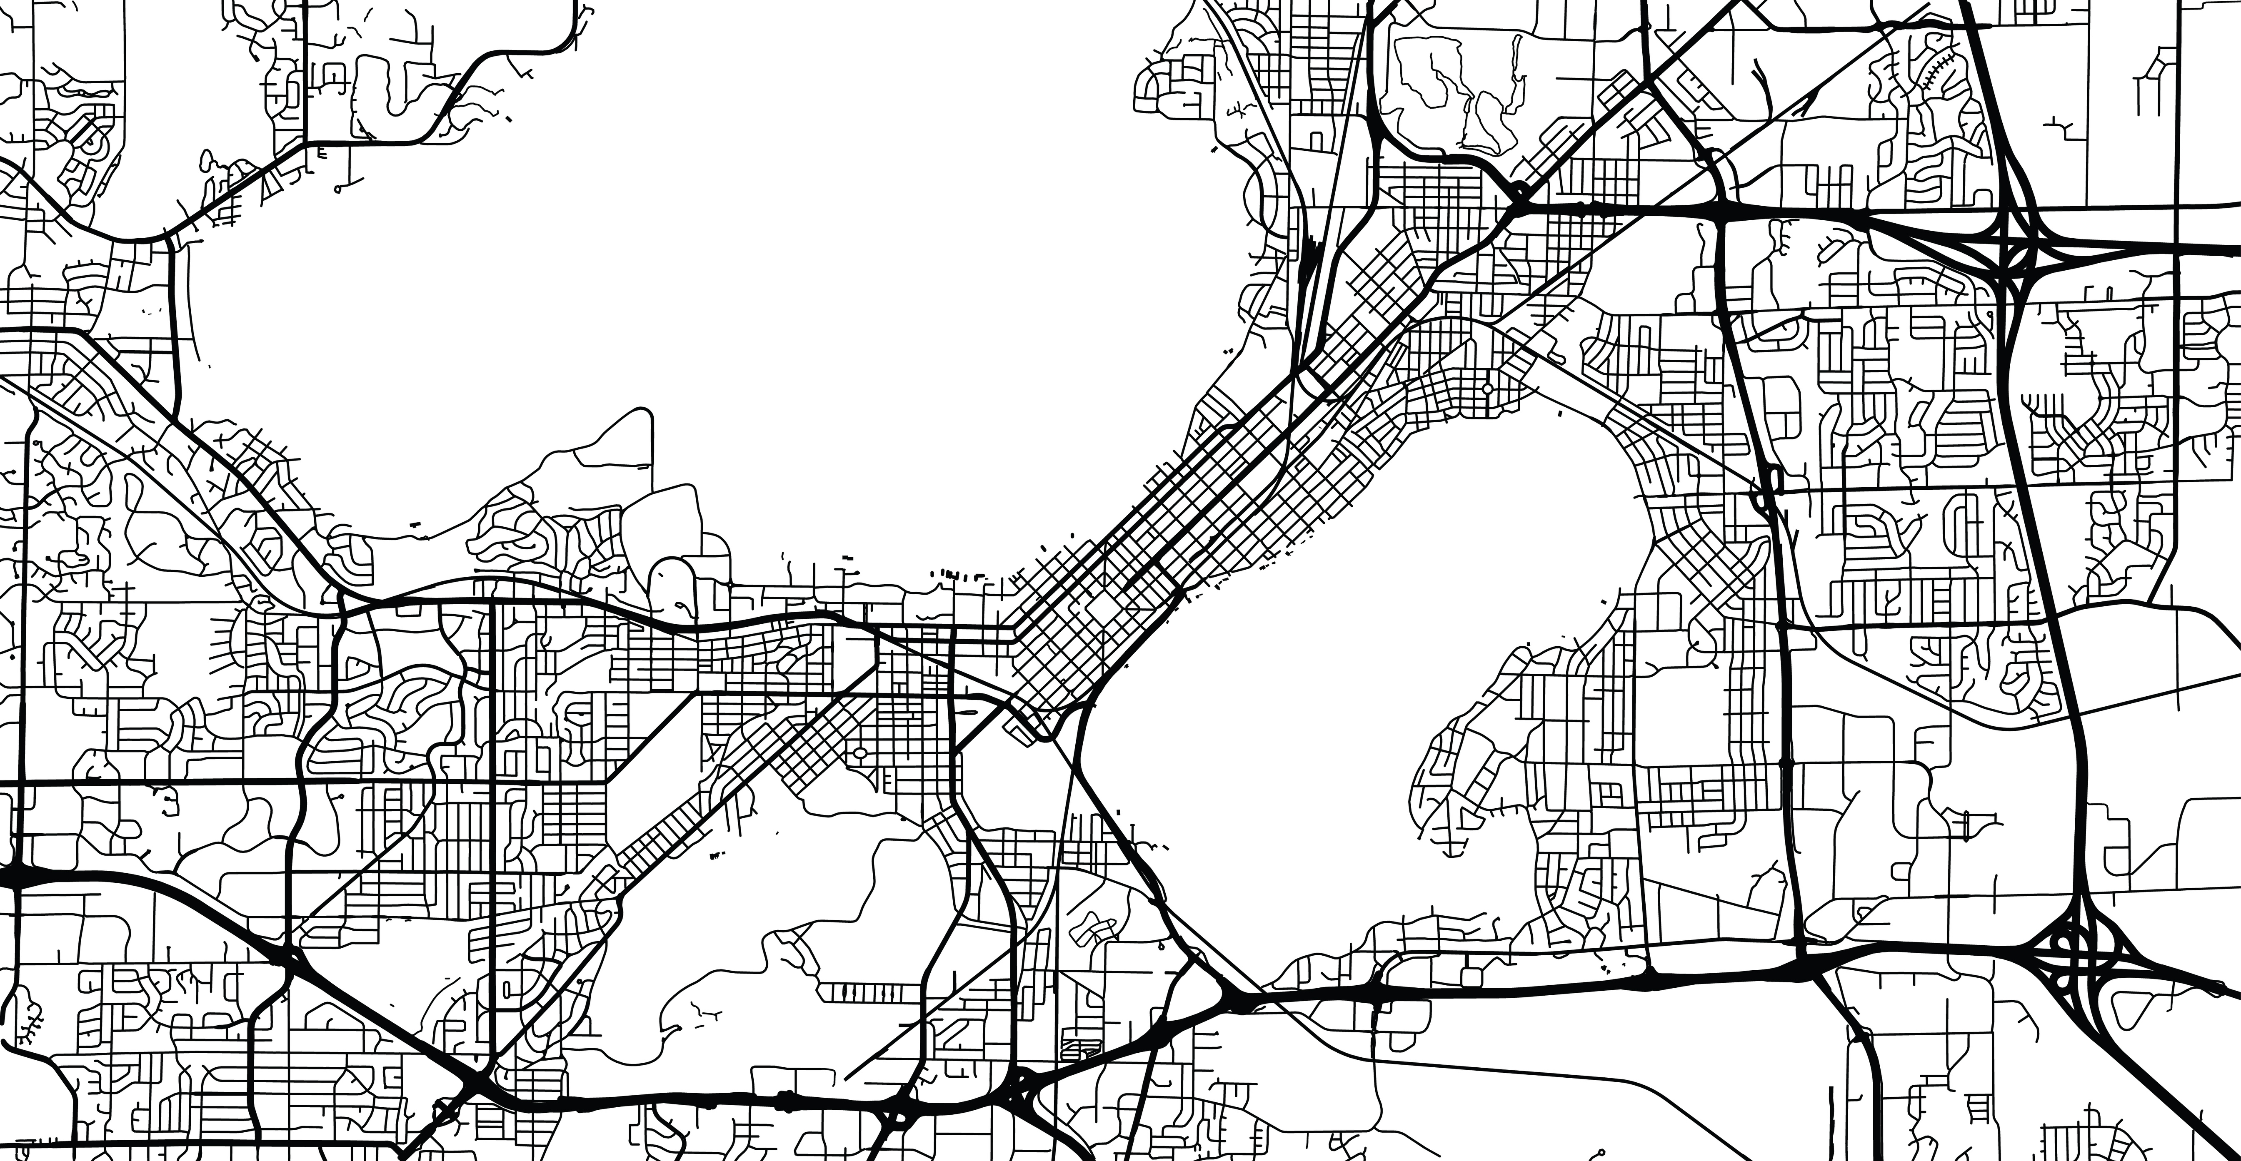
The Feasibility and Equity of
Geolocation Data for Lapse Prediction
in Alcohol Use Disorder (AUD)
Claire Punturieri
Department of Psychology
University of Wisconsin-Madison

Slide 2

Conclusion:
Proposed Study &
Contribution to Theory
Introduction:
Background & Aims
Methods:
Measures & Analytic Plan

Slide 3
Introduction
Background & Aims

Slide 4


A clear need for treatment…
29.5 million people diagnosed with AUD in 2022
Of those, only about 2.2 million received treatment
SAMHSA, 2022
Notes:
29.5 million people above the age of 12 were diagnosed with AUD in 2022, or about 1/10 of the general US population. However, only about 2.2 million received treatment, a little less than 1 in 10 of those initially diagnosed.

Slide 5
…but a clear lack of access & use
Barriers to treatment:
Financial ➯ cost-prohibitive
Interpersonal ➯ fear of judgment from friends and family
Intrapersonal ➯ internalized beliefs about handling substance use on one’s own
Burden of suffering unequally shared across the population:
Risk
Associated stigmas
Negative consequences from drinking
Access to and engagement with treatment
Calling et al., 2019; Davis & O’Neill, 2022; SAMHSA, 2022; Vaeth & Wang-Schweig, 2017; Witbrodt et al., 2014
Notes:
Why are so few of those diagnosed accessing and using treatment? A few of these barriers are finances (lack of insurance or costs even with coverage), interpersonal concerns (like a fear of how the opinions of others will change should one choose to seek treatment), and intrapersonal concerns (such as believing that one should be able to get better on one’s own).
At an even broader level, the burden of suffering of AUD is already unequally shared across the population: these are differences in risk of developing AUD, its associated stigmas, its consequences, and one’s access to and engagement with treatment across geographic location, race, sex, and socioeconomic status.

Slide 6
The promise of digital therapeutics
Digital therapeutics (“DTx”) ➯ services delivered via technology, such as smartphones
Begin to address barriers to AUD treatment:
Low financial, time commitment
Ability to engage while avoiding concerns of stigma
Available regardless of geographic location
Notes:
There is a major discrepancy between who is diagnosed with AUD and who engages in treatment. How can we think about narrowing this gap? One way is the emerging field of digital therapeutics, or DTx. Digital therapeutics deploy treatment services through technology, typically apps on smartphones. These services can be modules aimed at restructuring thinking or mindfulness, for example, or can also provide discussion boards to connect with other app users. DTx can help us start to improve treatment access and engagement by lowering financial and time barriers, alleviating some concerns about stigma, and preventing the need for travel to services.
But, the usefulness of a digital therapeutic is limited by how effectively someone uses it. How are individuals supposed to know when to engage with their DTx? What about which modules are the best for that individual to engage with at that time?

Slide 7
The promise of smart digital therapeutics
Smart digital therapeutics (“smart DTx”) ➯ services delivered via technology, such as smartphones, that take into account user data in order to suggest the optimal intervention at the right time
Improve upon DTx by:
Encouraging use at the right time – in mental health contexts, before some sort of unwanted outcome
Guiding interaction with relevant modules
Notes:
One way we may be able to remedy these issues is by trying to make DTx “smart”. In other words, we want to be able to suggest to individuals when and what parts of the DTx to use, thereby improving upon them by both encouraging use at the “right” time – and I will talk in a few slides about what that “right” time might be – and of relevant modules.

Slide 8
How do we get there?
Algorithms must be developed outright…
Need to perform well (i.e., pinpoint outcome of interest accurately)
Identify meaningful, actionable precursors on which to intervene
…with the goal of equity in mind
Demonstrate similar performance across different people
Provide a sustainable method of data collection for users
Notes:
But, how do we get there? Smart DTx don’t exist, and the “non smart” kinds are still in their early stages of development. First and foremost, these prediction algorithms must be developed: they have to do a good job at predicting whatever we decide that important outcome is, and also be able to help us intervene before an undesired outcome occurs. Secondly, these algorithms must be developed with the goal of equity in mind. If we are serious about deploying these tools in real world contexts with real people, we need to be able to show that these algorithms don’t only benefit some and not others, and that people seeking treatment can engage with them sustainably.
So next, I’d like to briefly outline what an algorithm designed to assist with AUD treatment might look like: including what it should measure, how it should measure it, and how we can begin to think about doing so equitably.

Slide 9
What outcome should these algorithms measure?
Relapse ➯ a return to previous levels of harmful use
Common occurrence during recovery process
Inconsistently defined in literature
Varies from person to person
Lapse ➯ single occurrence of goal-inconsistent use
Clearly defined
Easy to observe
Always precedes relapse
Can be tied to clinically-meaningful events (e.g., abstinence violation effect)
Marlatt & Gordon, 1985; McKay & Hiller-Sturmhofel, 2011; Moos & Moos 2006; Sliedrecht et al., 2022; Stillman & Sutcliff 2020; Witkiewitz & Marlatt, 2004
Notes:
First, what outcome should these algorithms measure? Relapse, or a return to previous levels of harmful use, is thought of as a common occurrence during the recovery process. Because of this, many researchers have identified it as being a potentially useful outcome target on which to intervene. However, the term “relapse” is very inconsistently defined in the literature, may vary greatly from person to person. Lapse, on the other hand, is a single occurrence of goal-inconsistent use and IS clearly defined. It is easy to observe, always precedes relapse by its very definition, and can also be tied to clinically-meaningful events, like the abstinence violation effect in which individuals return to previous levels of use following a lapse.
For these reasons, algorithms designed for DTx in AUD that use lapse as the primary outcome may be preferred and is what I will be using at the primary outcome in this project.

Slide 10
How should lapse risk be monitored?
Amenable data source for long-term DTx engagement:
Require little-to-no user input
Suitable to app users
Map onto theoretically-relevant constructs
Be able to keep up with day-to-day and person-to-person changes in risk
Notes:
So, now that we’ve decided on WHAT we should measure, how should we measure it? When choosing a data source to encourage long-term, real-world use of a digital therapeutic, we want something that requires little-to-no user input to alleviate burden and make sustained use feasible, we want it to be something that our app users will be comfortable with, it should map onto theoretically-relevant constructs so we know we are measuring what we actually think is important, and it should be able to keep up with how lapse risk fluctuates day to day and person to person.

Slide 11
Geolocation as data source
Amenable data source for long-term DTx engagement:
Require little-to-no user input
Suitable to app users
Map onto theoretically-relevant constructs
Be able to keep up with day-to-day and person-to-person changes in risk
Low burden, can solicit additional contextual information
Evidence for acceptability in context of AUD
Location important in both understanding risk and in treatment
Continuously sampled
Janak & Chaudhri, 2010; LeCocq et al., 2020; Stahler et al., 2013; Walton et al., 2003; Walton et al., 1995; Wyant et al., 2023
Notes:
One data source that could be promising for this line of work is geolocation data, which quantifies spatial positioning and movement across time. It is passive and therefore lower burder, with the option to occasionally solicit additional contextual information to enrich our data, such as frequently visited locations or the emotional valence associated with a location. Prior work in our lab has also demonstrated that geolocation data may be an acceptable sensing method in the context of AUD treatment monitoring. We know that location impacts risk of lapse in AUD and is also a part of some treatments like mindfulness-based relapse prevention, where individuals are taught coping skills that target substance-associated contexts. And finally, geolocation data are continuously collected. Unless we turn it off, our phones are constantly sampling our location as we move throughout the day. This level of granularity might help us better capture some facets of lapse risk that might be missed with other techniques like surveys, that are only deployed several times per day.

Slide 12
Developing algorithms with equity in mind
Fair algorithm ➯ no preference in performance with respect to inherent or acquired characteristics (e.g., gender, race, socioeconomic status)
Machine learning algorithms can help us understand statistical patterns in data, but can also unintentionally perpetuate patterns of inequities:
Can provide sub-optimal care to individuals who already face disadvantages
Lead to eroded trust and therefore lower use of these tools for those who may benefit the most
Wang et al., 2022
Notes:
And finally, how do we do all of this while keeping equity in mind? First, a definition: an algorithm is fair if there is no preference in performance with respect to inherent or acquired characteristics. In other words, an algorithm in our case should be able to do well predicting lapse regardless of someone’s socioeconomic status, for example. The really exciting part about using machine learning algorithms to improve treatment outcomes is that we can leverage large amounts of data and fancy statistics to reveal underlying patterns we might not’ve known otherwise – but these algorithms are based off of data collected in the real world, and so will have those norms entrenched within it. I’ll touch a little more on how this might show up in our data later on. Two main issues with this are that, if we don’t carefully examine our algorithms, we may end up providing sub-optimal care to individuals who already face disadvantages, leading to reduced trust and ultimately use of these tools by people who might benefit the most from them.

Slide 13
Specific aims
Aim 1: Train several machine learning algorithms to predict next-day alcohol lapse from contextualized geolocation data.
Aim 2: Select and evaluate the best-performing algorithm.
Aim 3: Evaluate the algorithmic fairness of the best-performing algorithm across subgroups who experience known treatment disparities in the context of AUD.
Notes:
With all of that in mind, this brings me to the specific aims for my first year project. In my next section I will walk through the different measures and approaches I will implement in order to meet these goals.

Slide 14
Methods
Measures & Analytic plan
Notes:
Now I’ll walk through the measures I will be using and my analytic plan for this project.

Slide 15
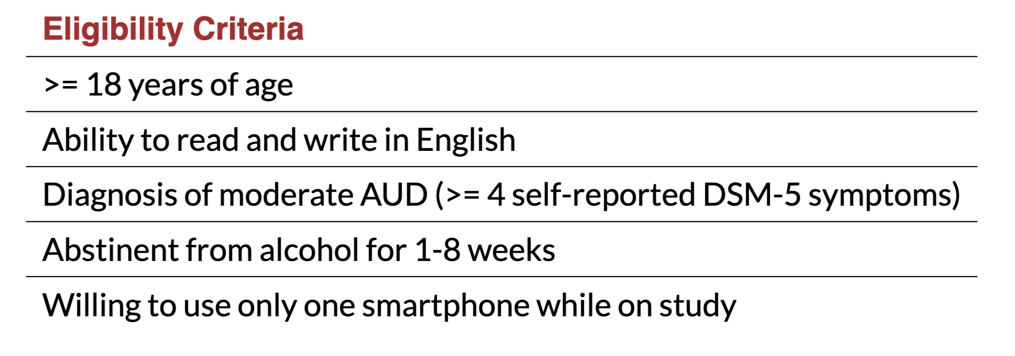
Participants
151 participants (21-72 years of age, 49% women) in early-recovery with a recovery goal of abstinence recruited from Madison area (R01 AA024391)
Notes:
I will be working with data collected under a previous NIAAA grant in my lab, which followed 151 participants from the Madison area in early-recovery who had a recovery goal of abstinence. They had to be a legal adult, be able to read and write in English, meet DSM-5 criteria for moderate AUD, have become recently abstinent, and be willing to use only one smartphone while on study. Participants were also screened for any severe symptoms of paranoia or psychosis.

Slide 16


Procedure
Five in-person visits, 4x daily surveys, and continuous passive monitoring of geolocation data
Screening &
Enrollment
Follow-up #1
Follow-up #2
Follow-up #3
ONE MONTH
ONE MONTH
ONE MONTH
Survey and geolocation data continuously collected throughout this period
Screening and enrollment:
Demographic and alcohol use-related information
Pre-reported frequently visited locations
Follow-up visits:
Asked contextual questions about frequently visited locations in past month (>2 times)
Notes:
As part of participating in the study, participants completed five in-person visits, daily surveys, and continuous passive monitoring of geolocation data.
During the enrollment period, participants provided information about their demographics and alcohol use. They also pre-reported known frequently visited locations.
Following this, daily surveys and geolocation data tracking began and participants completed three follow-up visits one month apart.
At each visit, participants were asked contextual questions about frequently visited (\>2 times during the course of the previous month) locations.

Slide 17
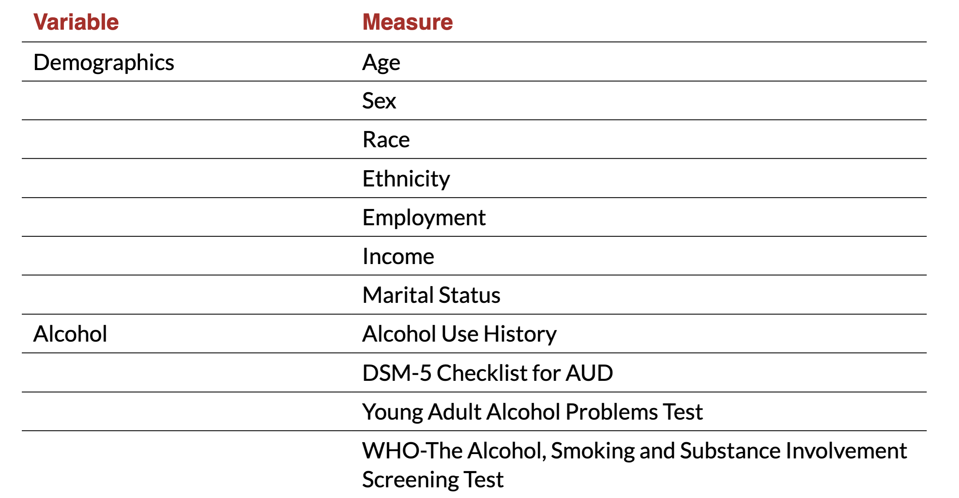
Measures: participant characteristics
Notes:
Participants completed a baseline measure of demographics and other constructs relevant to lapse at the screening visit, which will be used both for model building and for fairness assessments

Slide 18
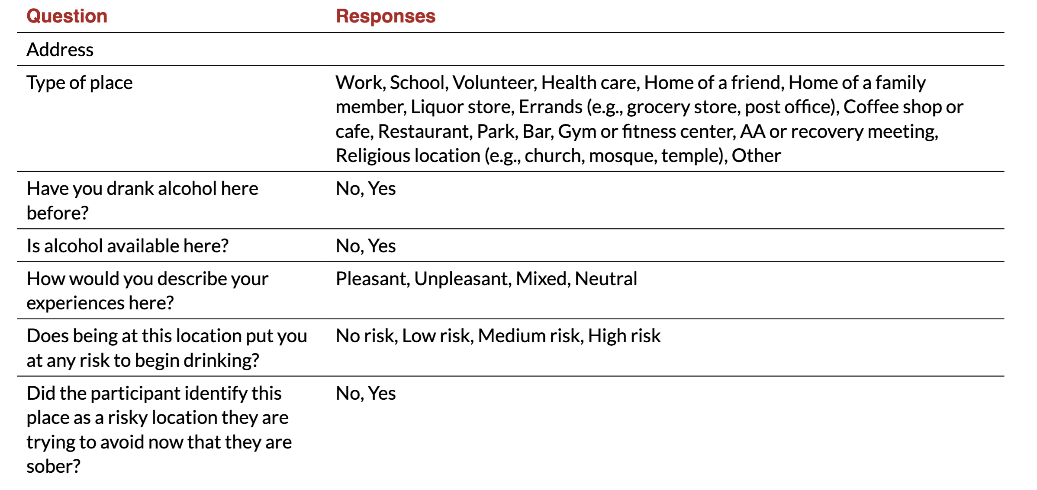
Measures: contextual information
Notes:
Contextual information for frequently visited locations (\>2 times in the previous month) was obtained during an interview at each follow-up visit (at month 1, 2, and 3; Table 2).

Slide 19


Measures: lapses
Next-day lapse occurrence predicted in 24-hour windows
Windows roll forward one hour, every hour
previously collected data
12:00am
6:00am
12:00pm
6:00pm
12:00am
6:00am
Notes:
Again, alcohol lapses will be used as our outcome variable in this study and will be used to provide labels for model training, for testing model performance, and for testing issues of algorithmic fairness. Future lapse occurrence (here conceptualized as next-day lapse) will be predicted in 24-hour rolling windows. Each prediction will use all of the previously collected geolocation data up until that point. This rolling window approach will take advantage of the granular, continuous nature of geolocation data, enabling hourly updating of predictions. ((ANIMATION)) In other words, the prediction will advance by one hour, every hour.
*Lapse* and *no lapse* occurrences will be identified from the daily survey question, *"Have you drank any alcohol that you have not yet reported?"*. Participants who responded *yes* to this question were then asked to report the date and hour of the start and the end of the drinking episode. In this case, the prediction window will be labeled *lapse*. Prediction windows will be labeled *no lapse* if no alcohol use was reported within that window.

Slide 20
Measures: lapses
Next-day lapse occurrence predicted in 24-hour rolling windows
previously collected data
12:00am
6:00am
12:00pm
6:00pm
12:00am
6:00am
Lapse and no lapse occurrences identified from daily survey question, “Have you drank any alcohol that you have not yet reported?”
Participants who responded yes to this question were then asked to report date and hour of start and end of drinking episode
Notes:
In other words, the prediction will advance by one hour, every hour.
*Lapse* and *no lapse* occurrences will be identified from the daily survey question, *"Have you drank any alcohol that you have not yet reported?"*. Participants who responded *yes* to this question were then asked to report the date and hour of the start and the end of the drinking episode. In this case, the prediction window will be labeled *lapse*. Prediction windows will be labeled *no lapse* if no alcohol use was reported within that window.

Slide 21
Feature engineering of geolocation data
Contextual information collected at each follow-up visit will be used to enrich geolocation features
With participant contextual information
Time spent at locations assoc. with neg. affect
Proximity to self-reported risky locations
Time spent at/near place to avoid in recovery
Time spent at places previously drank
Without participant contextual information
Proximity to liquor outlets (e.g., bars)
Socio-demographic feature space
Time spent at home (isolation)
Number of novel environments encountered
Substance use literature
Affective science literature
Both
Doryab et al., 2019a; Epstein et al., 2014a; Gustafson et al., 2014a; Heller et al., 2020; Kwan et al., 2019; Raugh et al., 2020; Shin & Bae, 2023
Notes:
One thing that sets this project apart from prior geolocation work is that we have contextual information to supplement our data. We can therefore make features both with and without this contextual information. Here are some examples of features I am considering for my project. These features at the top would use contextual information supplied by our participants whereas these features at the bottom can be generated without participant feedback. You’ve probably noticed that we have some different colors going on here!
To create features to be able to make lapse predictions from the geolocation data, I want to bridge two literatures in clinical psychology that have historically been quite siloed but that have both used this type of data. In the substance use literature, the most common use of geolocation data is to characterize and identify risky locations. On the other hand, the affective science literature focuses much more on mood, behavior, and the emergence of mood states: things like loneliness, isolation, and novelty.

Slide 22
Algorithm development & performance
Several classification candidate machine learning algorithms will be considered
Trained and assessed using grouped, nested k-fold cross-validation
Best model configuration selected using median area under the Receiver Operating Characteristic curve (auROC)
Secondary performance metrics: sensitivity, specificity, positive predictive value (PPV), negative predictive value (NPV)
Jonathan et al., 2000; Kuhn & Johnson, 2018
Notes:
Following feature engineering of the geolocation data, I will consider several classification candidate machine learning algorithms to predict next-day lapse which will be trained and assessed using participant-grouped, nested *k*-fold cross-validation.
[[Grouped cross-validation assigns all data from a participant as either held-in or held-out to avoid bias introduced when predicting a participant’s data from their own data. Nested cross-validation uses two nested loops for dividing and holding out folds: an outer loop, where held-out folds serve as test sets for model evaluation; and inner loops, where held-out folds serve as validation sets for model selection.]]
The primary performance metric for model selection and evaluation will be area under the Receiver Operating Characteristic Curve, or auROC, which indexes the probability that the model will predict a higher score for a randomly selected positive case (lapse) relative to a randomly selected negative case (no lapse).
[[auROC is an aggregate measure of sensitivity and specificity. The best model configuration will be selected using median auROC across all validation sets.]]
Several secondary performance metrics including sensitivity, specificity, positive predictive value (PPV), and negative predictive value (NPV) will also be assessed.

Slide 23


Algorithm development & performance
SHAP (Shapley Additive exPlanations) computed as interpretability metric
Provides information about what features are most important…
…for individual predictions
…for all predictions
Local ➯ contribution of features in algorithm’s predictions for a particular observation
Global ➯ contribution of features in algorithm’s predictions for all observations
Lundberg & Lee, 2017
Notes:
Next, SHAP (SHapley Additive exPlanations) values will be computed as our interpretability metric to identify the relative importance of different features in the final algorithm. SHAP values measure the unique contribution of features in an algorithm's predictions and can be examined both globally, for all participants, and locally, for a particular participant.
Highly important features represent relevant, actionable potential antecedents to lapse (and therefore points of intervention) that will be relevant in the future development of a smart DTx.

Slide 24
Algorithmic fairness
Representation in our data
Data set primarily white and non-Hispanic
Performance of models for poorly represented individuals in this sample may be less accurate
Representation in previous data
AUD literature historically built upon research developed with male, predominantly white, participants
This shapes our perceptions as researchers of what we think is important and most helpful to study
Location’s known contributions to mental health inequities
Exposure to substances, neighborhood disadvantage, barriers to treatment stratified by location contribution to initiation, maintenance of AUD
Mennis et al., 2016; Scott et al., 2020
Notes:
And finally, I will talk a bit about algorithmic fairness. Though the nature of data collection in this study avoids certain inequities (e.g., by virtue of not using data collected in a health care setting), there are particular concerns specific to this work which motivate interrogating the fairness of models developed during this project.
Firstly, while the data set for this study has a range of age and sex representation (21-72 years of age, 49% women), it is primarily white (86.8%) and non-Hispanic (97.4%). Having a limited number of observations within other groups means that our models will not have as wide a range of individuals to learn from for making predictions of lapse as compared to white, non-Hispanic participants. More data generally means better predictions. Performance of these models for racialized minority individuals may therefore be less accurate as a result.
Second, the AUD literature has historically been built upon research developed with male, predominantly white, participants. By the very nature of its historically limited participant pool, AUD research and its theory have been developed from a particular perspective using a particular group of individuals. This means that the variables that we decide are important to measure and input into our models in this study, informed by our knowledge of AUD theory, will inherently be biased and may favor men. Therefore, despite the fact that our models will have equivalent representation across sex, we should not anticipate that this is enough to compensate for biases brought on by the broader societal context. Indeed, this fact should also be kept in mind when exploring model performance across other "well-balanced" categories such as age in our models.
Finally, Location plays an important role in contributing to mental health inequities, and it is no different for AUD. Exposure to substances, neighborhood disadvantage, and barriers to treatment stratified by location all contribute to the initiation and maintenance and experiences with AUD
These three facts motivate the reasoning behind examining algorithmic fairness in this current project.

Slide 25
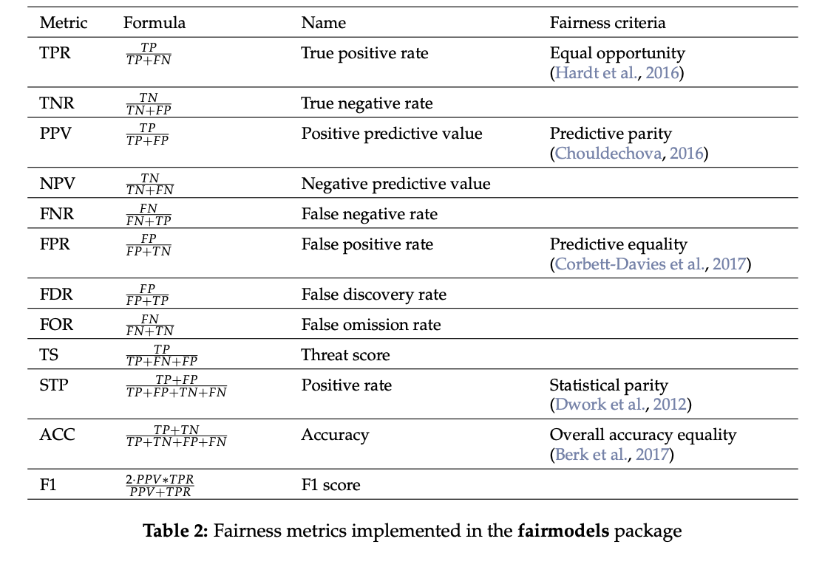
Algorithmic fairness
No concrete standards of reporting, but many established metrics for statistically assessing fairness
Predicated on assignment of “privileged” and “non-privileged” group
Measures like accuracy can be examined between groups
Can be repeated over many combinations to assess model performance across various identities
Foulds et al., 2020; Wang et al., 2022; Wisniewski & Biecek, 2022
Notes:
But how am I going to quantify that? Conversations around machine learning and fairness in healthcare have existed in the literature for several years yet no concrete standards of reporting of algorithmic fairness have been delineated.
Despite the fact that standards of reporting do not exist, there are many established metrics for statistically assessing algorithmic fairness. Common metrics of algorithmic fairness are predicated on the assignment of a "privileged" and "non-privileged" group. Once this has been established, measures such as accuracy can be examined between those two groups. This can be repeated over many combinations of privileged and non-privileged groups to assess model performance across various identities.
On the righthand side, I am showing an example of different metrics I might be interested in exploring relating to algorithmic fairness which are already implemented within the $Rpackage “fairmodels”.
However, one thing I am interested in pursuing with this project is moving past these binary ways of conceptualizing privilege and fairness and identity and instead applying an intersectional lens to these fairness analyses. I didn’t put this in my written proposal because I didn’t want to overpromise, but it is something I’d really like to discuss with you all! I see these initial analyses as still being incredibly useful, but also as being a stepping stone to more intricate fairness analyses that can better approximate people in the real world and not falsely reduce them to single dimensions.

Slide 26
Conclusion
Proposed Study & Contribution to Theory

Slide 27
Proposed study
My proposed first-year project will apply machine learning to predict next-day lapse in AUD utilizing geolocation data with the aim of advancing both prediction (when a lapse might occur) and explanatory (why a lapse might occur) goals.

Slide 28
Proposed study
I will build a model to predict next-day lapse with an almost entirely passive data stream, supplemented with contextual information, for individuals with a recovery goal of abstinence (Aim 1)
I will evaluate the best-performing model and examine what geolocation features are most predictive of an oncoming lapse (Aim 2)
I will critically examine the fairness of the best-performing model (Aim 3)

Slide 29
Contribution to theory
Identify the most predictive features which contribute to lapse from a minimally burdensome and continuously collected data source
Utilize features created by leveraging modeling techniques from both the substance use and affective subdisciplines (transdiagnostic approach)
Provide a critical evaluation of model performance beyond auROC by including examination of algorithmic fairness
Advocate for transparency in reporting fairness metrics alongside standard measures of model performance
Notes:
Lastly, I would like to touch on how this project will contribute to theory in the applied mental health and AUD literatures. If successful, this study will contribute both to our ability to both predict and explain lapse in AUD as well as how we approach designing equitable machine learning models.
((between third and fourth bullet point)
Though many fairness metrics have been used in simulated data or in publicly available data few researchers in applied mental health settings have made use of these tools to critically examine their own models.

Slide 30
Thank you!
Feedback welcomed!

Slide 31
References
Calling, S., Ohlsson, H., Sundquist, J., Sundquist, K., & Kendler, K. S. (2019). Socioeconomic status and alcohol use disorders across the lifespan: A co-relative control study. PloS one, 14(10), e0224127.
Davis, C. N., & O’Neill, S. E. (2022). Treatment of alcohol use problems among rural populations: a review of barriers and considerations for increasing access to quality care. Current Addiction Reports, 9(4), 432-444.
Doryab, A., Villalba, D. K., Chikersal, P., Dutcher, J. M., Tumminia, M., Liu, X., ... & Dey, A. K. (2019). Identifying behavioral phenotypes of loneliness and social isolation with passive sensing: statistical analysis, data mining and machine learning of smartphone and fitbit data. JMIR mHealth and uHealth, 7(7), e13209.
Epstein, D. H., Tyburski, M., Craig, I. M., Phillips, K. A., Jobes, M. L., Vahabzadeh, M., ... & Preston, K. L. (2014). Real-time tracking of neighborhood surroundings and mood in urban drug misusers: application of a new method to study behavior in its geographical context. Drug and alcohol dependence, 134, 22-29.
Foulds, J. R., Islam, R., Keya, K. N., & Pan, S. (2020, April). An intersectional definition of fairness. In 2020 IEEE 36th International Conference on Data Engineering (ICDE) (pp. 1918-1921). IEEE.
Gustafson, D. H., McTavish, F. M., Chih, M. Y., Atwood, A. K., Johnson, R. A., Boyle, M. G., ... & Shah, D. (2014). A smartphone application to support recovery from alcoholism: a randomized clinical trial. JAMA psychiatry, 71(5), 566-572.
Heller, A. S., Shi, T. C., Ezie, C. C., Reneau, T. R., Baez, L. M., Gibbons, C. J., & Hartley, C. A. (2020). Association between real-world experiential diversity and positive affect relates to hippocampal–striatal functional connectivity. Nature Neuroscience, 23(7), 800-804.
Janak, P. H., & Chaudhri, N. (2010). The potent effect of environmental context on relapse to alcohol-seeking after extinction. The open addiction journal, 3, 76.
Jonathan, P., Krzanowski, W. J., & McCarthy, W. V. (2000). On the use of cross-validation to assess performance in multivariate prediction. Statistics and Computing, 10, 209-229.
Kuhn, M., & Johnson, K. (2013). Applied predictive modeling (Vol. 26, p. 13). New York: Springer.
Kwan, M. P., Wang, J., Tyburski, M., Epstein, D. H., Kowalczyk, W. J., & Preston, K. L. (2021). Uncertainties in the geographic context of health behaviors: A study of substance users’ exposure to psychosocial stress using GPS data. In Uncertainty and Context in GIScience and Geography (pp. 47-66). Routledge.
LeCocq, M. R., Randall, P. A., Besheer, J., & Chaudhri, N. (2020). Considering drug-associated contexts in substance use disorders and treatment development. Neurotherapeutics, 17(1), 43-54.
Lundberg, S. M., & Lee, S. I. (2017). A unified approach to interpreting model predictions. Advances in neural information processing systems, 30.
Marlatt, G. A., & Donovan, D. M. (Eds.). (2007). Relapse prevention: Maintenance strategies in the treatment of addictive behaviors. Guilford press.
McKay, J. R., & Hiller-Sturmhöfel, S. (2011). Treating alcoholism as a chronic disease: approaches to long-term continuing care. Alcohol Research & Health, 33(4), 356.
Mennis, J., Stahler, G. J., & Mason, M. J. (2016). Risky substance use environments and addiction: a new frontier for environmental justice research. International journal of environmental research and public health, 13(6), 607.
Moos, R. H., & Moos, B. S. (2006). Rates and predictors of relapse after natural and treated remission from alcohol use disorders. Addiction, 101(2), 212-222.
Raugh, I. M., James, S. H., Gonzalez, C. M., Chapman, H. C., Cohen, A. S., Kirkpatrick, B., & Strauss, G. P. (2020). Geolocation as a digital phenotyping measure of negative symptoms and functional outcome. Schizophrenia bulletin, 46(6), 1596-1607.
SAMHSA, Center for Behavioral Health Statistics and Quality. 2022 National Survey on Drug Use and Health. Table 5.32A – Received substance use treatment in past year: among people aged 12 and older; by age group and past year drug use disorder, past year alcohol use disorder, past year drug and alcohol use disorder, and past year substance use disorder, numbers in thousands, 2021 and 2022. [cited 2024 May 2]. Available from: https://samhsa.gov/data/sites/default/files/reports/rpt42728/NSDUHDetailedTabs2022/NSDUHDetailedTabs2022/NSDUHDetTabsSect5pe2022.htm?s=5.32&#tab5.32a
SAMHSA, Center for Behavioral Health Statistics and Quality. 2022 National Survey on Drug Use and Health. Table 5.32B – Received substance use treatment in past year: among people aged 12 and older; by age group and past year drug use disorder, past year alcohol use disorder, past year drug and alcohol use disorder, and past year substance use disorder, percentages, 2021 and 2022. [cited 2024 May 2]. Available from: https://samhsa.gov/data/sites/default/files/reports/rpt42728/NSDUHDetailedTabs2022/NSDUHDetailedTabs2022/NSDUHDetTabsSect5pe2022.htm?s=5.32&#tab5.32b
SAMHSA, Center for Behavioral Health Statistics and Quality. 2022 National Survey on Drug Use and Health. Table 5.1A – Substance use disorder for specific substances in past year: among people aged 12 and older; by age group, numbers in thousands, 2021 and 2022. [cited 2024 May 2]. Available from: https://samhsa.gov/data/sites/default/files/reports/rpt42728/NSDUHDetailedTabs2022/NSDUHDetailedTabs2022/NSDUHDetTabsSect5pe2022.htm?s=5.1&#tab5.1a
Scott, J., Danos, D., Collins, R., Simonsen, N., Leonardi, C., Scribner, R., & Herd, D. (2020). Structural racism in the built environment: Segregation and the overconcentration of alcohol outlets. Health & place, 64, 102385.
Shin, J., & Bae, S. M. (2023). A systematic review of location data for depression prediction. International Journal of Environmental Research and Public Health, 20(11), 5984.
Sliedrecht, W., Roozen, H., de Waart, R., Dom, G., & Witkiewitz, K. (2022). Variety in alcohol use disorder relapse definitions: Should the term “relapse” be abandoned?. Journal of Studies on Alcohol and Drugs, 83(2), 248-259.
Stahler, G. J., Mennis, J., & Baron, D. A. (2013). Geospatial technology and the “exposome”: new perspectives on addiction. American journal of public health, 103(8), 1354-1356.
Stillman, M. A., & Sutcliff, J. (2020). Predictors of relapse in alcohol use disorder: Identifying individuals most vulnerable to relapse. Addiction and Substance Abuse, 1(1), 3-8.
Vaeth, P. A., Wang‐Schweig, M., & Caetano, R. (2017). Drinking, alcohol use disorder, and treatment access and utilization among US racial/ethnic groups. Alcoholism: Clinical and Experimental Research, 41(1), 6-19.
Walton, M. A., Blow, F. C., Bingham, C. R., & Chermack, S. T. (2003). Individual and social/environmental predictors of alcohol and drug use 2 years following substance abuse treatment. Addictive behaviors, 28(4), 627-642.
Walton, M. A., Reischl, T. M., & Ramanathan, C. S. (1995). Social settings and addiction relapse. Journal of Substance Abuse, 7(2), 223-233.
Wang, A., Ramaswamy, V. V., & Russakovsky, O. (2022, June). Towards intersectionality in machine learning: Including more identities, handling underrepresentation, and performing evaluation. In Proceedings of the 2022 ACM Conference on Fairness, Accountability, and Transparency (pp. 336-349).
Wisniewski, J., & Biecek, P. (2022). fairmodels: a Flexible Tool for Bias Detection, Visualization, and Mitigation in Binary Classification Models. R J., 14(1), 227-243.
Witbrodt, J., Mulia, N., Zemore, S. E., & Kerr, W. C. (2014). Racial/ethnic disparities in alcohol‐related problems: Differences by gender and level of heavy drinking. Alcoholism: Clinical and Experimental Research, 38(6), 1662-1670.
Witkiewitz K, Marlatt GA. Relapse prevention for alcohol and drug problems: that was Zen, this is Tao. Am Psychol. 2004 May-Jun;59(4):224-35.
Wyant, K., Sant'Ana, S. J., Fronk, G., & Curtin, J. J. (2023). Machine learning models for temporally precise lapse prediction in alcohol use disorder. PsyArXiv. September, 27.

